Slide 1
Real Life Application of First Order Differential Equation
Submitted by
Submitted to
Name: B M Shahria Alam
ID: 2021-3-60-016
Department of CSE
East West University
Dr. Anindita Paul
Professor
Department of MPS
East West University

Slide 2
First Order Differential Equation
A differential equation is an equation involving derivatives of an unknown function and possibly the function itself as well as the independent variable.
First Order since it only depends upon the concentration linearly

Slide 3
Some uses of First Order Differential Equation
Some uses of ODE in real life are:
01
Carbon Dating
02
Growth and Decay
03
Newton’s Law of cooling
04
Series Circuits
05
Skydiving
06
Rocket Motion
07
Mixture

Slide 4
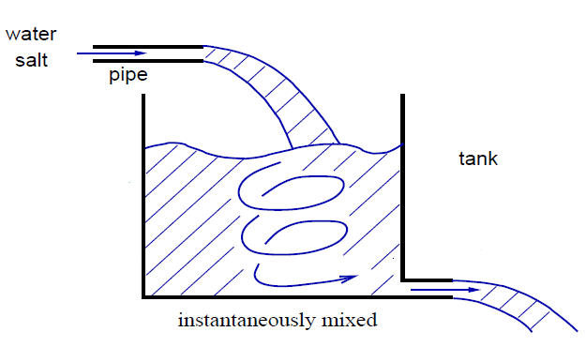

Real life problem
Source: Google
(shorturl.at/gARSU)
We assumed that the rate A(t) at which the amount of salt in the mixing tank change was a net rate:
$\frac{dA}{dt}$ = (input rate of salt) – (output rate of salt)
= R_{in} – R_{out}

Slide 5
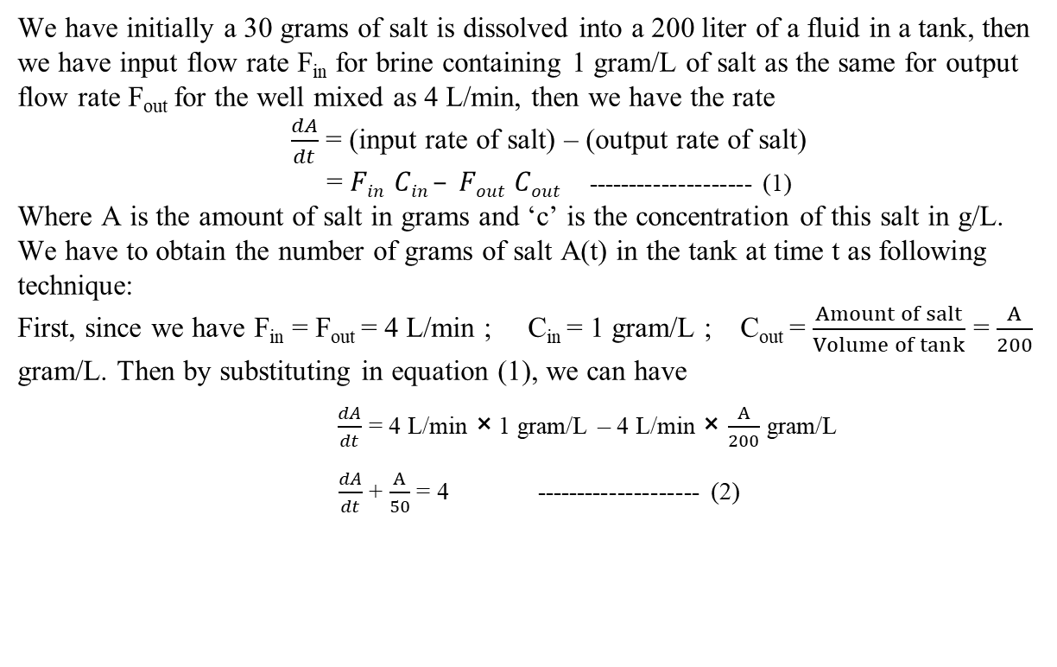
Example:
A tank contains 200 liters of fluid in which 30 grams of salt is dissolved. Brine containing 1 gram of salt per liter is then pumped into the tank at a rate of 4 L/min; the well-mixed solution is pumped out at the same rate. Find the number A(t) of grams of salt in the tank at time t.
We have initially a 30 grams of salt is dissolved into a 200 liter of a fluid in a tank, then we have input flow rate F_{in} for brine containing 1 gram/L of salt as the same for output flow rate F_{out} for the well mixed as 4 L/min, then we have the rate
$\frac{dA}{dt}$ = (input rate of salt) – (output rate of salt)
= $Fin Cin – Fout Cout$-------------------- (1)
Where A is the amount of salt in grams and ‘c’ is the concentration of this salt in g/L.
We have to obtain the number of grams of salt A(t) in the tank at time t as following technique:
First, since we have F_{in} = F_{out} = 4 L/min ; C_{in} = 1 gram/L ; C_{out} = $\frac{Amount of salt}{Volume of tank}$ = $\frac{A}{200}$
gram/L. Then by substituting in equation (1), we can have
$\frac{dA}{dt}$ = 4 L/min × 1 gram/L – 4 L/min × $\frac{A}{200}$ gram/L
$\frac{dA}{dt}$ + $\frac{A}{50}$ = 4 -------------------- (2)

Slide 6
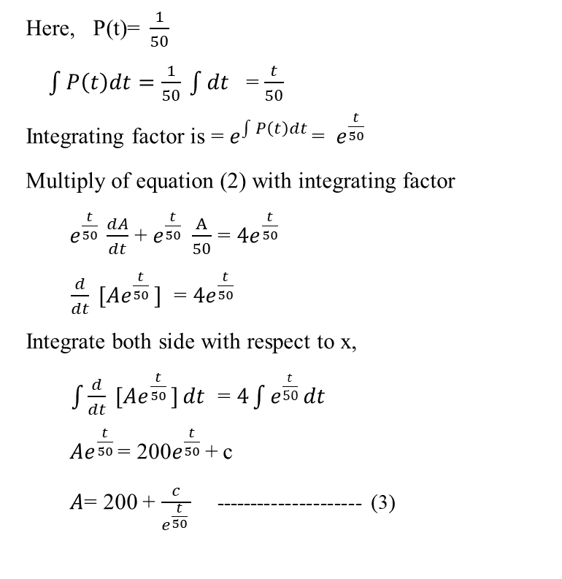
After that, since equation (2) is a linear and separable, we can find integrating factor and then do integration
Here, P(t)=$\frac{1}{50}$
$\int{P\left(t\right)dt=\frac{1}{50} }\int{dt }$ = $\frac{t}{50}$
Integrating factor is = $e^{\int{P\left(t\right)dt }}$= $e^{\frac{t}{50} }$
Multiply of equation (2) with integrating factor
$e^{\frac{t}{50} }\frac{dA}{dt}$ + $e^{\frac{t}{50} }$ $\frac{A}{50}$ = ${4e}^{\frac{t}{50} }$
$\frac{d}{dt} [Ae^{\frac{t}{50} }]$ = ${4e}^{\frac{t}{50} }$
Integrate both side with respect to x,
$\int{\frac{d}{dt} [Ae^{\frac{t}{50} }]}dt$ = $4\int{e^{\frac{t}{50} }dt}$
$Ae^{\frac{t}{50} }$= 200$e^{\frac{t}{50} }$+ c
$A$= 200 + $\frac{c}{e^{\frac{t}{50} }}$ --------------------- (3)

Slide 7
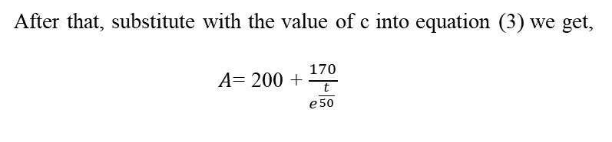
Now to find the value of constant c, we have to apply the point (A,t)= (30 grams, 0 minutes) into equation (3)
30 = 200 - c
C = 170
After that, substitute with the value of c into equation (3) we get,
$A$= 200 + $\frac{170}{e^{\frac{t}{50} }}$
This is the number of grams of salt in tank at time t.

Slide 8
Thank You

